Slide 1

Continuous Delivery For Modules to the PowerShell Gallery
Rob Sewell @sqldbawithbeard https://sqldbawithAbeard.com

Slide 2
speaker questionnaire
Name : Rob (although Chrissy calls me Beard ☺ )
Occupation : DBA, Automator, Do-er, Trainer, DevOpser!
Available for hire ☺ - RobSewell.info
Interests : PowerShell, Automation And SQL (PaaS geddit?)
Interesting Fact : Beard. (Still) Plays Cricket, Flies Drone
Speaker : PsConfEU, PsConfAsia, PSSaturdays, PSMondays, User Groups PowerShell and SQL
Community : PowerShell VG, PowerShell Conference EU Organiser, PSDayUK Organiser, SQL South West , SQL Sat Exeter , dbatools, dbachecks, MVP

Slide 3
TODAY’s TO DO LIST
GET UP
Drink Coffee
Learn Loads at Polar Conf
Create Continuous Delivery Process for Delivering Modules to the PowerShell Gallery
Appropriate Liquid

Slide 4
Continuous Delivery For Modules to the PowerShell Gallery
Rob Sewell @sqldbawithbeard https://sqldbawithAbeard.com

Slide 5
speaker questionnaire
Name : Rob (although Chrissy calls me Beard ☺ )
Occupation : DBA, Automator, Do-er, Trainer, DevOpser!
Available for hire ☺ - RobSewell.info
Interests : PowerShell, Automation And SQL (PaaS geddit?)
Interesting Fact : Beard. (Still) Plays Cricket, Flies Drone
Speaker : PsConfEU, PsConfAsia, PSSaturdays, PSMondays, User Groups PowerShell and SQL
Community : PowerShell VG, PowerShell Conference EU Organiser, PSDayUK Organiser, SQL South West , SQL Sat Exeter , dbatools, dbachecks, MVP

Slide 6
TODAY’s TO DO LIST
GET UP
Drink Coffee
Learn Loads at Polar Conf
Create Continuous Delivery Process for Delivering Modules to the PowerShell Gallery
Appropriate Liquid

Slide 7
https://www.facebook.com/WoodyandKleiny/videos/233476763989513/?t=109

Slide 8
What do we need?
Plaster – Install-Module Plaster
Pester – Install-Module Pester
(Need to take ownership and remove existing Pester folder first)
Or use -SkipPublisherCheck

Slide 9
What do we need?
Plaster – Install-Module Plaster
Pester – Install-Module Pester
GitHub Account
Azure DevOps account
We won‘t have time for much detail!!

Slide 10
Why PowerShell Module?
Ps1 scripts EVERYWHERE!!
Use functionality in other scripts
Share them internally or externally
Modularity
Only export functions user needs

Slide 11

Why PowerShell Gallery?
#SadJoey
#SadJoey

Slide 12
Why PowerShell Gallery?
Public or Private Nuget Repository
Share your Modules
Make them easier to find
Centralise deployment of Modules

Slide 13
Why Plaster?
Reusability
Parametrisation
Organisational requirements
If you are doing it more than once automate it ☺

Slide 14
Why Pester?
Verify the code is working correctly
Provide design guidance - Support Refactoring
Document the code’s behaviour
If you are doing it more than once automate it ☺
Notes:
Good tests can…
Verify the code is working correctly
Prevent future regressions
Document the code’s behaviour
Provide design guidance
Support refactoring
https://www.devmynd.com/blog/five-factor-testing/

Slide 15
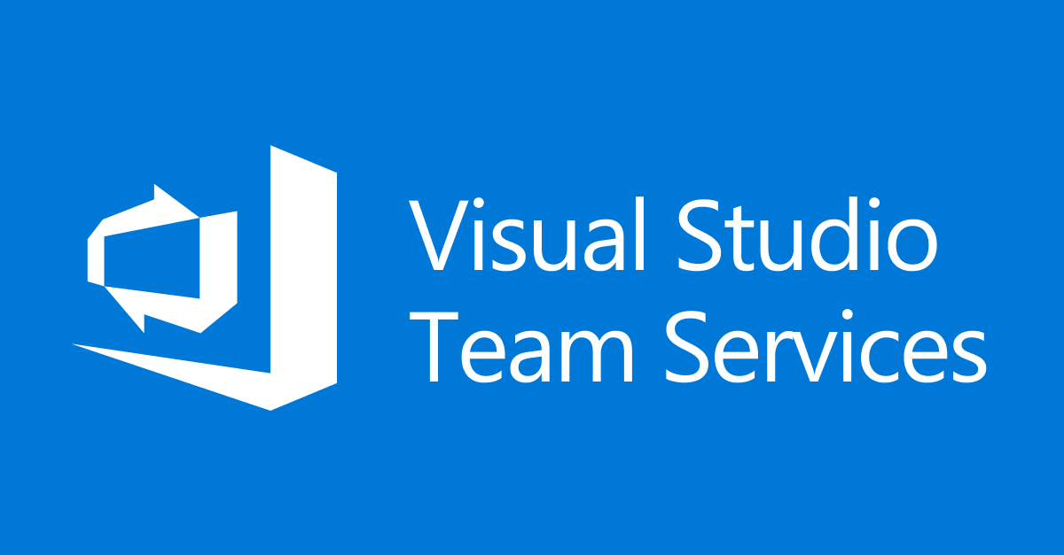

Visual Studio Online
Visual Studio Team Services

Slide 16

Visual Studio Team Services
Azure DevOps

Slide 17
Azure DevOps

Slide 18
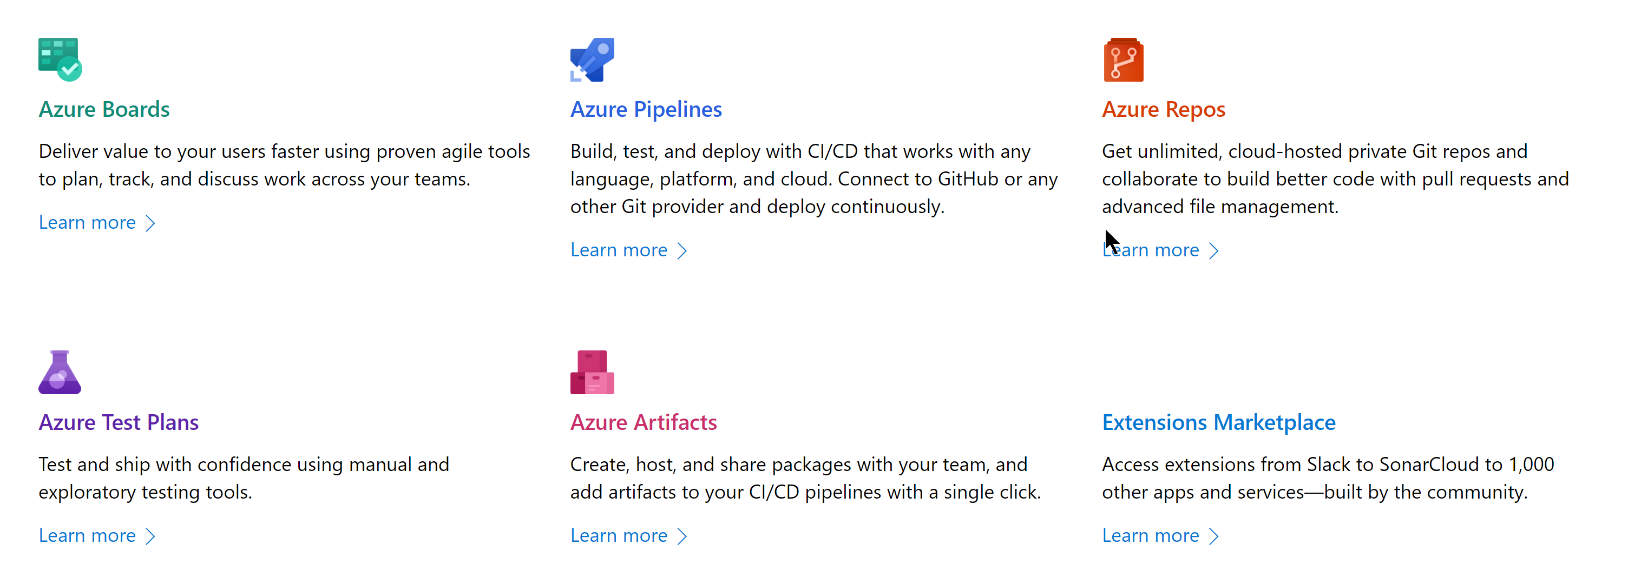
Azure DevOps
https://azure.microsoft.com/en-us/services/devops/

Slide 19

Azure DevOps

Slide 20
Azure DevOps
https://azure.microsoft.com/en-us/services/devops/

Slide 21

Azure DevOps

Slide 22
Azure DevOps
https://azure.microsoft.com/en-us/services/devops/

Slide 23

Azure DevOps

Slide 24
Azure DevOps
https://azure.microsoft.com/en-us/services/devops/

Slide 25

Azure DevOps

Slide 26
Azure DevOps
https://azure.microsoft.com/en-us/services/devops/

Slide 27

Azure DevOps

Slide 28
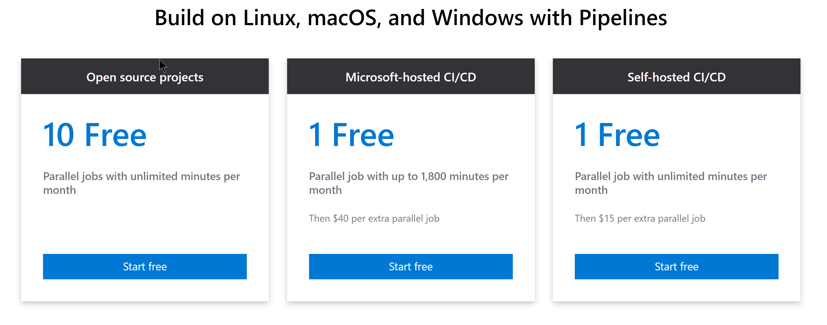
Azure DevOps
https://azure.microsoft.com/en-us/services/devops/

Slide 29
What to do with Azure DevOps?
Unit Test with Build Step on merge to Development
Update Module Number
Sign Code with Certificate using Secure Files
Publish to Gallery
If you are doing it more than once automate it ☺
Notes:
PowerShell Gallery is not for testing!

Slide 30

Hey Beardy – Enough Talk!
Time For A DEMO

Slide 31
Summary
Continuous Delivery of PowerShell Module to the Gallery is easy Plaster can template your module framework
Pester is a Unit Testing Framework for PowerShell
Azure DevOps is free
Have Fun – Create some modules today
Rob Sewell @sqldbawithbeard https://sqldbawithAbeard.com

Slide 32
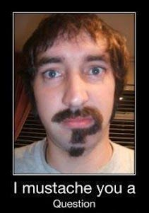
Questions?
?
?
?
?
?
?
?
?
?
?
?
?
?
?
?
?
Rob Sewell @sqldbawithbeard https://sqldbawithAbeard.com

